Slide 1
GemFire v Redis
When to use which
Mike Stolz, Principal Field Engineer

Slide 2
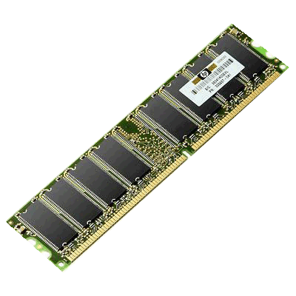

Horizontally Scalable and Elastic
Memory Oriented + Durable
Active Everywhere – Multi-Site
Key/Value Object Store

Slide 3
Redis is an in-memory “data structure store”, used as database, cache and message broker.
It supports data structures such as strings, hashes, lists, sets, sorted sets with range queries, bitmaps, hyperloglogs and geospatial indexes with radius queries.

Slide 4
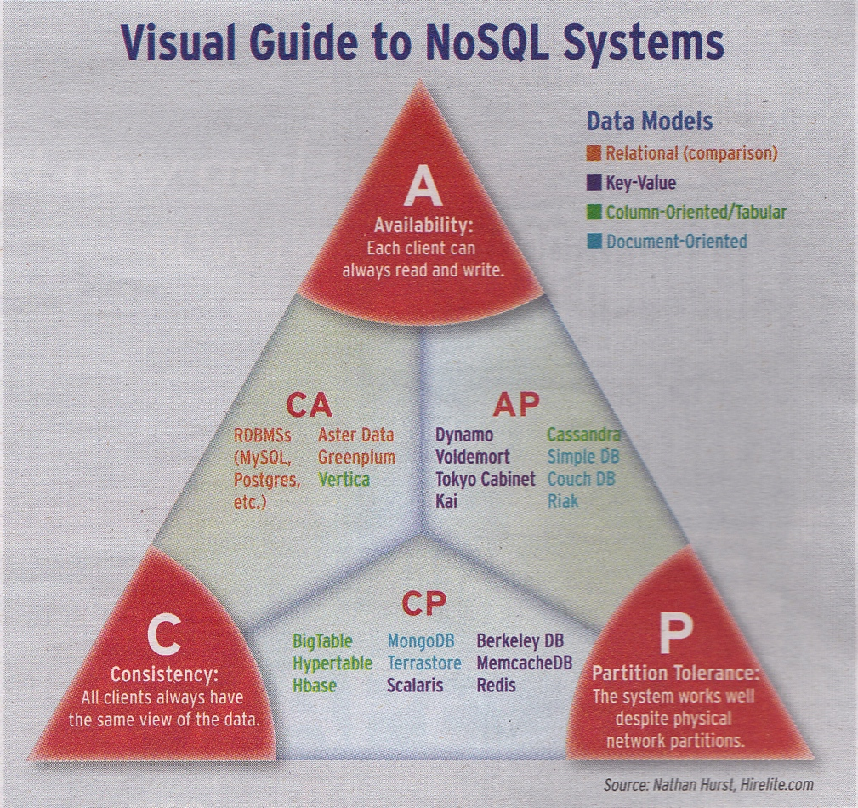
The CAP Triangle
In a distributed system you MUST have Partition Tolerance. Therefore you have to trade between Availability and Consistency. You can’t have both.
This was mathematically proven by Seth Gilbert and Nancy Lynch of MIT in 2002.
http://en.wikipedia.org/wiki/CAP_theorem
GemFire

Slide 5
Redis and CAP Theorem
Redis was designed originally as a single-server system. As a consequence it was by definition of any single-server system, CP. It can be distributed either by master-slave or multi-master with Redis Sentinel protocol.
Jepsen: Redis (https://aphyr.com/posts/283-jepsen-redis) shows that both ways to distribute Redis have the potential to lose both data consistency and also can lose persistent data in the presence of network partitions. So not only is Redis not CP, but loses data forever (something which GemFire doesn't).
It is important to recognize that Redis does not guarantee durability. Since writes to disk and replication to secondaries are asynchronous, we can lose up to N seconds of the most recent writes if the primary node fails even if the secondaries are still up.

Slide 6
From the Redis Cluster Tutorial at http://redis.io/topics/cluster-tutorial
Redis Cluster is not able to guarantee strong consistency. In practical terms this means that under certain conditions it is possible that Redis Cluster will lose writes that were acknowledged by the system to the client.
The first reason why Redis Cluster can lose writes is because it uses asynchronous replication. This means that during writes the following happens:
Your client writes to the master B.
The master B replies OK to your client.
The master B propagates the write to its slaves B1, B2 and B3.
As you can see B does not wait for an acknowledge from B1, B2, B3 before replying to the client, since this would be a prohibitive latency penalty for Redis, so if your client writes something, B acknowledges the write, but crashes before being able to send the write to its slaves, one of the slaves (that did not receive the write) can be promoted to master, losing the write forever.

Slide 7
Performance: http://redis.io/topics/benchmarks
Redis performance is good, but that’s because data replication is async (thus, no consistency guarantee). Performance should be compared with GemFire using D_NO_ACK replication policy, which is also asynchronous. In this case, GemFire will out-perform Redis on situations with lots simultaneous client connections, because Redis is a single-threaded server by design. If you’re deploying it on multiple core servers, you would have to run as many instances of Redis as there are cores on each server.

Slide 8
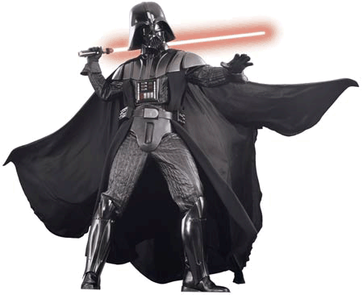
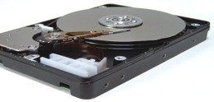
The Enemy Of Performance Is Latency
Disk is 100 times slower than main memory and 3X slower than LAN
Read 1 MB from memory 250,000 ns
Read 1 MB from SSD 1,000,000 ns
Disk seek 6,000,000 ns
Send 1 MB over LAN 10,000,000 ns
Read 1 MB from disk 20,000,000 ns

Slide 9


Distributed Events
Active
Pub/Sub and
Continuous Query
Notes:
The differences between the way Redis and GemFire deal with distributed events is that Redis events are the direct result of someone “publishing” something, whereas GemFire events are the direct result of someone doing a put(key, value), and the key and value are part of the event. The other difference is that if you MISSED the event on GemFire, the change to the data is still in the cache, so you can go pick it up in a similar fashion to the way Kafka works.

Slide 10
Partitioning and Co-location Example
Customers
Orders
Shipments
Payments
Other Customer related
Partitioned Data
Partitioned Regions model One-to-Many and Many-to-One
Data Fabric Node
Data Fabric Node
Data Fabric Node
Data Fabric Node
Many-to-Many, Many-to-One and One-to-Many relationships can be modeled
Co-location of related data eliminates distributed transactions
Notes:
*** PRESENTATION ONLY***
The bulk of the data that will be held in the common backbone is considered Active Data. It tends to be much larger and change more frequently than Reference Data. For this example, we will continue to consider the case of an Equities trading system, although other types of banking tend to follow the same patterns very closely.
In a trading system, the active data would be comprised of information that describes the banks position with respect to the different instruments, information about trades and current market data. Because this data is large, we will use the ability of the data fabric to partition the data across multiple nodes in the fabric <<BUILD>>. Partitioning is automatic, and partition sizes will be kept in balance and can grow or shrink to take advantage of additional hardware or in response to hardware failure – this feature is commonly call ‘elasticity’. The data fabric is capable of ensuring that data that is used together is kept on the same node, for performance reasons. This is called ‘colocation’. And because the data is now spread across multiple nodes, the data fabric provides clients with the ability to connect to multiple nodes <<BUILD>> either physically or virtually (by proxy through another server). These connections are automatically managed and load balanced, and any affinity between the data that an application is using and the node it is stored on will be recognized by the fabric and the connections will be optimized to take advantage of that affinity.

Slide 11
Partitioning and Co-location Example
Product Descriptions
Pricing Data
Inventory
Replicated Regions model Many-to-Many Relationships
Data Fabric Node
Data Fabric Node
Data Fabric Node
Data Fabric Node
Many-to-Many, Many-to-One and One-to-Many relationships can be modeled
Co-location of related data eliminates distributed transactions
Notes:
*** PRESENTATION ONLY***
One of the central features our Model Bank is to establish what is called ‘the Golden Copy’. The Golden Copy is a centralized, master copy of the data, stored in the backbone, that will be used for many purposes throughout the bank. Any information that reflects a material effect on the past, current or even future positions or obligations of the bank should pass through and be stored in the Golden Copy. For the most part this information changes relatively slowly and infrequently or, in many cases, it never changes. We call this slowly changing but commonly read data ‘Reference Data’. <<BUILD>>
Some of this data is very specific between the bank and its trading partners such as counterparty descriptions, settlement instructions and netting agreements. This data tends to be keyed in and updated manually, or perhaps it is updated by some other business system as part of an enterprise business process or workflow.
In other cases, the data is information about commonly traded instruments and so it comes in from data sources such as Bloomberg , Reuters or Quick.
Because this reference data tends to be used by all of the applications, and is relevant to all of the other data that will be stored in the data fabric, it will be replicated throughout the nodes of the fabric. In practice, the reference data may be selectively replicated to selective nodes, but for simplicity at this point, we should think of it as being available in all nodes and kept up to date in all nodes. The rate of change of the reference data is slow, so it is not hard for the data fabric to manage multiple, synchronized copies of the data.

Slide 12
Data-Aware Function Routing
Targeted
Data Aware Function
Batch Controller or Client
Execute your Java code right where the data lives.
Notes:
GemFire provides for procedural and/or event driven function execution in situ (localized with) the data. This allows data intensive applications to have nanosecond access to data. Moving the behavior to the data instead of moving the data to the behavior is not only orders of magnitude faster, but significantly reduces the load on the network.
GemFire uses ‘Data Aware’ routing to accept hints from the application to decide where the optimal place to execute the function may be. GemFire also provides Scatter-Gather and Map-Reduce features to provide massively parallel function execution. Long running functions and queries can stream results back to the client for truly interactive and real-time user interfaces.

Slide 13
Parallel Function Execution and Queries
Parallel
Batch Controller or Client
Scatter-Gather (Map-Reduce) Queries and Functions
Notes:
GemFire provides for procedural and/or event driven function execution in situ (localized with) the data. This allows data intensive applications to have nanosecond access to data. Moving the behavior to the data instead of moving the data to the behavior is not only orders of magnitude faster, but significantly reduces the load on the network.
GemFire uses ‘Data Aware’ routing to accept hints from the application to decide where the optimal place to execute the function may be. GemFire also provides Scatter-Gather and Map-Reduce features to provide massively parallel function execution. Long running functions and queries can stream results back to the client for truly interactive and real-time user interfaces.

Slide 14



Consistency Model
Data Fabric Node
Data Fabric Node
Data Fabric Node
Data Fabric Node
Data Fabric Node
Data Fabric Node
Data Fabric Node
Data Fabric Node
Archival, OLAP & Regulatory RDBMS
Synchronous Consistency within the Fabric
Database Node
Eventual Consistency with Archival Database
Eventual Consistency with other Fabric instances
Storage Device
Notes:
*** PRESENTATION ONLY***
The bulk of the data that will be held in the common backbone is considered Active Data. It tends to be much larger and change more frequently than Reference Data. For this example, we will continue to consider the case of an Equities trading system, although other types of banking tend to follow the same patterns very closely.
In a trading system, the active data would be comprised of information that describes the banks position with respect to the different instruments, information about trades and current market data. Because this data is large, we will use the ability of the data fabric to partition the data across multiple nodes in the fabric <<BUILD>>. Partitioning is automatic, and partition sizes will be kept in balance and can grow or shrink to take advantage of additional hardware or in response to hardware failure – this feature is commonly call ‘elasticity’. The data fabric is capable of ensuring that data that is used together is kept on the same node, for performance reasons. This is called ‘colocation’. And because the data is now spread across multiple nodes, the data fabric provides clients with the ability to connect to multiple nodes <<BUILD>> either physically or virtually (by proxy through another server). These connections are automatically managed and load balanced, and any affinity between the data that an application is using and the node it is stored on will be recognized by the fabric and the connections will be optimized to take advantage of that affinity.

Slide 15
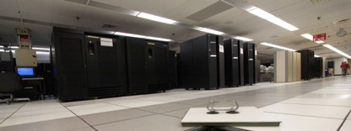

Multi-Site Capability
Active Everywhere
Data Fabric Node
Data Fabric Node
Data Fabric Node
Data Fabric Node
Single Cluster Spanning Data Centers
Notes:
GemFire uses three topologies in order to achieve its high level of reliability, scalability and speed.
The first--and the backbone of the system--is the peer-to-peer topology represented by the top cloud on this slide.
In this configuration, everybody knows about everybody else.
If a new node joins the distributed system, everybody gets notified.
If a node leaves, everybody gets notified.
This enables us to dynamically move workload around within the distributed system.
There is no notion of a “broker”. No single point of failure.
Fault tolerance is designed right in.
The trouble with peer-to-peer architectures, is that they have so much meta-data flying around that they can only have limited scale. We generally recommend that this topology only be scaled up to about 100 or 200 nodes.
In order to scale further, we use a client-server topology represented by the second cloud on this slide.
In this topology, we elect some of the peers from the peer-to-peer backbone, to be servers for client applications. Each server may manage as many as 100 clients. There is much less metadata overhead in this topology, so it can scale to thousands of nodes.
We have tested up to 4000 nodes with no problems. 4000 was not the limit of what we could handle, we just couldn’t get hour hands on enough computers to test any further.
The third topology is the WAN Gateway topology.
In this topology, we glue together multiple of the client-server distributed systems using the GemFire WAN Gateway. This is an ideal way of creating a grid that is globally distributed, so it looks like one big distributed system, even though it is really many distributed systems glued together.

Slide 16



Multi-Site Capability
Active Everywhere
Asynchronous, Fault Tolerant, Bi-Directional WAN Gateway
Notes:
GemFire uses three topologies in order to achieve its high level of reliability, scalability and speed.
The first--and the backbone of the system--is the peer-to-peer topology represented by the top cloud on this slide.
In this configuration, everybody knows about everybody else.
If a new node joins the distributed system, everybody gets notified.
If a node leaves, everybody gets notified.
This enables us to dynamically move workload around within the distributed system.
There is no notion of a “broker”. No single point of failure.
Fault tolerance is designed right in.
The trouble with peer-to-peer architectures, is that they have so much meta-data flying around that they can only have limited scale. We generally recommend that this topology only be scaled up to about 100 or 200 nodes.
In order to scale further, we use a client-server topology represented by the second cloud on this slide.
In this topology, we elect some of the peers from the peer-to-peer backbone, to be servers for client applications. Each server may manage as many as 100 clients. There is much less metadata overhead in this topology, so it can scale to thousands of nodes.
We have tested up to 4000 nodes with no problems. 4000 was not the limit of what we could handle, we just couldn’t get hour hands on enough computers to test any further.
The third topology is the WAN Gateway topology.
In this topology, we glue together multiple of the client-server distributed systems using the GemFire WAN Gateway. This is an ideal way of creating a grid that is globally distributed, so it looks like one big distributed system, even though it is really many distributed systems glued together.

Slide 17
Which to use?
It depends what you need…
You need Redis if you need…
Lists: collections of string elements sorted according to the order of insertion.
Sets: collections of unique, unsorted string elements.
Sorted sets, similar to Sets but where every string element is associated to a floating number value, called score.
Hashes, which are maps composed of fields associated with values. Both the field and the value are strings.
Bit arrays (or simply bitmaps): it is possible, using special commands, to handle String values like an array of bits: you can set and clear individual bits, count all the bits set to 1, find the first set or unset bit, and so forth.

Slide 18
Which to use?
It depends what you need…
You need GemFire if you need…
Synchronous consistency within the cluster (zero data loss)
Fault-tolerant write-behind to backing database
Multi-site Active/Active capability
Data aware function execution
Map-reduce style function execution
Arbitrarily complex domain object graphs
SQL-like queries (ODMG Object Query Language standard)

